Slide 2


Boot Other
*
*
*
*
*
*
*
* *
* *
*
Hecklaw os hex
Press Enter to start

Slide 4

3:35
Weather
Mon Tue Wed
News
Benjamin loyed sets fire to corp…

Slide 5
3:35
Login
Weather
Mon Tue Wed
LCMG
News
Benjamin loyed sets fire to corp…

Slide 6
3:35
Login
Enter Your Password
Weather
Mon Tue Wed
News
Benjamin loyed sets fire to corp…

Slide 7
3:35
Login
Enter Your Password
Weather
*
Mon Tue Wed
News
Benjamin loyed sets fire to corp…

Slide 8
3:35
Login
Enter Your Password
Weather
**
Mon Tue Wed
News
Benjamin loyed sets fire to corp…

Slide 9
3:35
Login
Enter Your Password
Weather
***
Mon Tue Wed
News
Benjamin loyed sets fire to corp…

Slide 10
3:35
Login
Enter Your Password
Weather
****
Mon Tue Wed
News
Benjamin loyed sets fire to corp…

Slide 11
3:35
Login
Enter Your Password
Weather
*****
Mon Tue Wed
Next
News
Benjamin loyed sets fire to corp…

Slide 12










HecklawvOS 10.0 Run Help Window
3:35
Weather
This PC
Mon Tue Wed
News
Benjamin loyed sets fire to corp…

Slide 13






HecklawvOS 10.0 Run Help Window
Weather
This PC
Mon Tue Wed
News
Benjamin loyed sets fire to corp…
Simulation z
Hecklaw files
Game hub
Qwerty chaos
He Mail
Lcmg Hexplorer Camera Settings Chalk talk
HePhone DrawNPaint
Menu
About
Settings
Power

Slide 14
HecklawvOS 10.0 Run Help Window
LCMG
Weather
This PC
Power
Mon Tue Wed
Whats my Hecklaw?
Task-Manager
Uninstall an app
News
Switch user
Benjamin loyed sets fire to corp…
Log-out

Slide 15
HecklawvOS 10.0 Run Help Window
Weather
This PC
Mon Tue Wed
News
Shutdown
Restart
Sleep
Benjamin loyed sets fire to corp…

Slide 16
HecklawvOS 10.0 Run Help Window
Weather
This PC
Heapp.heapp
Mon Tue Wed
News
Benjamin loyed sets fire to corp…

Slide 17
HecklawvOS 10.0 Run Help Window
Weather
This PC
DrawNPaint.
Mon Tue Wed
Press Shift+L to turn on pen, Press Shift+A to reset document
New Doc
News
Benjamin loyed sets fire to corp…

Slide 18
HecklawvOS 10.0 Run Help Window
Weather
This PC
New Doc
Mon Tue Wed
News
Benjamin loyed sets fire to corp…

Slide 19
HecklawvOS 10.0 Run Help Window
Hecklaw Explorer
Weather
This PC
New Tab
Mon Tue Wed
Hecklaw Explorer
News
Benjamin loyed sets fire to corp…
Search
Go

Slide 20
HecklawvOS 10.0 Run Help Window
Hecklaw Explorer
Weather
This PC
New Tab
Mon Tue Wed
Hecklaw Explorer
News
Benjamin loyed sets fire to corp…
lcmg
Go

Slide 21
HecklawvOS 10.0 Run Help Window
HF Hecklaw Files
Weather
Weather
Select
This PC
This PC
Mon Tue Wed
C:/L75
S:/Dwankle files
Mon Tue Wed
HE Mail
News
Benjamin loyed sets fire to corp…

Slide 22
HecklawvOS 10.0 Run Help Window
HF Hecklaw Files
Weather
Weather
Weather
S:/Dwankle_Files
This PC
This PC
This PC
Mon Tue Wed
C:/L75
S:/Dwankle_Files
Mon Tue Wed
DISKMAN.HEAP
Os1.dat
Os2.dat
Os3.dat
Os4.dat
Mon Tue Wed
HE Mail
HE Mail
News
Benjamin loyed sets fire to corp…

Slide 23
HecklawvOS 10.0 Run Help Window
HF Hecklaw Files
Weather
Weather
Weather
C:/L75
This PC
This PC
This PC
Mon Tue Wed
C:/L75
S:/Dwankle_Files
Mon Tue Wed
Dswitch.Heapp
QwertyChaos.Heappcontainer
QwertyChaos.Heapp
He.Heappcontainer
HF.Heapp
HE.Heapp
SimulationZ.Heapp
SimulationZ.Heappcontainer
HeMail.Heappcontainer
HeMail.Heapp
Rallydally.sys
QuestStorage.sysdata
Mon Tue Wed
HE Mail
HE Mail
News
Benjamin loyed sets fire to corp…

Slide 24
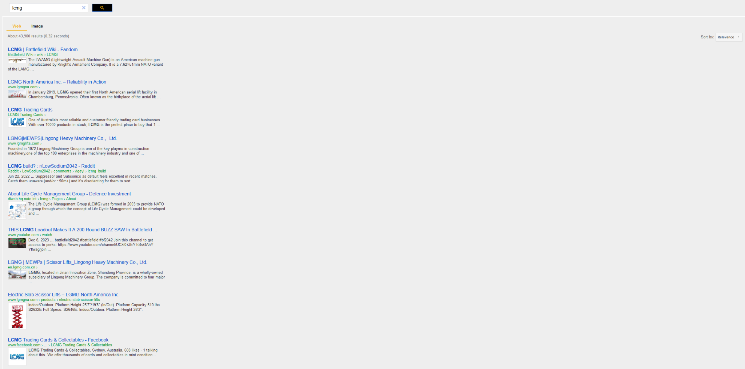
HecklawvOS 10.0 Run Help Window
Hecklaw Explorer
Weather
This PC
Lcmg search
Mon Tue Wed
News
Benjamin loyed sets fire to corp…

Slide 25
HecklawvOS 10.0 Run Help Window
Weather
hecklaw is a computer and meant to have user-friendly functions
This PC
hecklaw is a unique computer.heapp
Mon Tue Wed
News
Benjamin loyed sets fire to corp…

Slide 26
HecklawvOS 10.0 Run Help Window
Weather
This PC
Uninstaller.heapp
Mon Tue Wed
Dswitch.Heapp
QwertyChaos.Heapp
HE.Heapp
SimulationZ.Heapp
HeMail.Heapp
News
Benjamin loyed sets fire to corp…
Hecklawfilesystem.AAP
GOS.SYSLOAD

Slide 27
HecklawvOS 10.0 Run Help Window
Weather
This PC
Uninstaller.heapp
Mon Tue Wed
Dswitch.Heapp
QwertyChaos.Heapp
HE.Heapp
SimulationZ.Heapp
HeMail.Heapp
ERROR Code: X55 protocall
Uninstaller.heapcontainer could not found.
Please try uninstalling the app with uninstaller.heapp
News
Benjamin loyed sets fire to corp…

Slide 28
HecklawvOS 10.0 Run Help Window
Weather
This PC
Sysinfo.heapp
More
Mon Tue Wed
Hecklaw Pc Heix
Hecklaw OS 10
32Gb Ram
Zoi gpu 20 cores
K7 8 core 4.5Ghz Cpu
X
H
News
Benjamin loyed sets fire to corp…

Slide 29
HecklawvOS 10.0 Run Help Window
3:35
Weather
More
This PC
Sysinfo.heapp
Mon Tue Wed
Display: hecklaw quad 5k
Storage: 2Tb
Serial Number: X93rfTg::km2
News
Benjamin loyed sets fire to corp…

Slide 30
HecklawvOS 10.0 Run Help Window
Weather
General
This PC
Settings
Mouse & k…
Mon Tue Wed
Display
News
Benjamin loyed sets fire to corp…

Slide 31
HecklawvOS 10.0 Run Help Window
Weather
General
This PC
Settings
Mouse & k…
Mon Tue Wed
Display
Mouse
To activate custom cursor press: L
News
Benjamin loyed sets fire to corp…

Slide 32
HecklawvOS 10.0 Run Help Window
Weather
General
This PC
Settings
Mouse & k…
Mon Tue Wed
Display
Brightness +
News
Contrast +
Benjamin loyed sets fire to corp…
Saturation +

Slide 33

HecklawvOS 10.0 Run Help Window
Camera
Weather
This PC
Mon Tue Wed
News
Benjamin loyed sets fire to corp…

Slide 34
Hecklaw os Repair
EXIT
REPAIR NOW

Slide 35
Preparing for first boot
Booting from
repair-2
Click here to start
Hecklaw 10 OS 2024

Slide 36
scandisk
Your system is being scanned
memory=yes
fans=yes
Graphics card=yes
motherboard=yes
wifi/ethernet adapter=yes
Power supply=yes
cooler=yes
audio=yes
video=yes
System files=yes
L75 files=yes
v
Scan complete
restart

Slide 37
restore
X
Ready to restore
Are you sure you want to restore this hecklaw to its factory settings
restore
Please wait 5 seconds

Slide 38
HECKLAW OS HAS BEEN RESTORED TO ITS FACTORY SETTINGS
Press Enter+2 to reboot
CLICK HERE TO ENTER KERNEL
CLICK HERE TO ENTER BIOS
Clearing data

Slide 39



HECKLAW:UEFI.K94
x
Temperature
CPU = 30F
GPU = 20F
Full Computer = 50F
CPU LOAD 38%
GPU LOAD
78%

Slide 40
HECKLAW:UEFI.K94
x
Bios
settings
Kernel
Restart
Bootmgr.APES
Recovery
Scandisk.aap
Data
BOOTLOAD.aap
Powered by dwankle
Temperature
CPU = 30F
GPU = 20F
Full Computer = 50F
CPU LOAD 38%
GPU LOAD
78%

Slide 41
HECKLAW:UEFI.K94
x
Bios
settings
Kernel
Restart
Bootmgr.APPS
Recovery
Scandisk.aap

Slide 42
Scandisk.aap
X:S://
Recovery
Bootmgr.APES
Boot without media (NOT RECOMMENDED)

Slide 43
BootMGR.AAP
GINETium O.S Boot
Arch (99) O.S Boot
GOS Developer Boot

Slide 44

Data output
Repairing…..
L75 Files recovered
Restoring system OS
Stage one complete
Attempting to run L75 Core programs
Core Programs run: successful
Finishing repair
Checking computer state
State = repaired
Repair complete please click
Here to reboot
Starting Stage 2
Recovering files
|
|
|
Files recovered
Installing drivers
7 drivers missing
Installing drivers
Drivers installed
Running benchmark
Benchmark result:
Gpu 100/ 150
Cpu 135/ 150
Ram 90/ 150
Overall: 123/ 150
Your system is being scanned
memory=yes
fans=yes
Graphics card=suboptmal
motherboard=yes
wifi/ethernet adapter=bad
Power supply=yes
cooler=yes
audio=yes
video=yes
System files=corupted
L75 files=bad
v
lcmg technology

Slide 45
x:> >No bootable Media or install Media found, please reinstall the system operating system or remove any external drives with no operating system. Press enter to go to startup repair.<<

Slide 46
Stop Bug Check
LOG:
HECKLAW caller: Unknown Stop bug check
Arch(70).dall
Arch.(Goslauncher).boot
HECKLAW caller: Could not read
GHEX(SYSTEM-FILES).dall
GHEX(PREBOOT:1).GHEB
GHEX(PREBOOT:575).GHEB
OS MUST BE REINSTALLED OR WIPED PLEASE CLICK RESTORE OR REPAIR IF REPAIR FAILS RESTORE
Reboot
Hecklaw os Recovery
Restore
Repair

Slide 47
Hecklaw os Repair Error
HECKLAW repair has failed please try again or restore.
Click here to open recovery
Hecklaw 10 OS 2023

Slide 48
Hecklaw os Missing files
Your hecklaw is missing 2 L75 files please launch repair to fix.
Click here to open repair
Hecklaw 10 OS 2023

Slide 49
Hecklaw os Fatal Error
The os has experienced a fatal error and it cannot continue.
Click here to open recovery
Hecklaw 10 OS 2023

Slide 50
Hecklaw os Boot Error
The os has experienced a fatal Boot error and it cannot continue.
Click here to open recovery
Hecklaw 10 OS 2023

Slide 51
Hecklaw os Gos Error
The os has experienced a fatal GOS system error and it cannot continue.
Click here to enter X://
Hecklaw 10 OS 2023

Slide 52
X:// Loaded Press Enter to type

Slide 53
X://C://

Slide 54
X://C://Sys\

Slide 55
X://C://Sys\Gos.dev

Slide 56
X://C://Sys\Gos.dev(run):

Slide 57
X://C://Sys\Gos.dev(run):Gui@local

Slide 58
Gui 1.0 Loading Please wait
………………………………………………………………………………………………………………………………………………………………………………
………………………………………………………………………………………………………………………………………………………………………………
………………………………………………………………………………………………………………………………………………………………………………
………………………………………………………………………………………………………………………………………………………………………………
………………………………………………………………………………………………………………………………………………………………………………
………………………………………………………………………………………………………………………………………………………………………………
………………………………………………………………………………………………………………………………………………………………………………
………………………………………………………………………………………………………………………………………………………………………………
………………………………………………………………………………………………………………………………………………………………………………
………………………………………………………………………………………………………………………………………………………………………………
………………………………………………………………………………………………………………………………………………………………………………
………………………………………………………………………………………………………………………………………………………………………………
………………………………………………………………………………………………………………………………………………………………………………
Gui 1.0 Loaded Press Enter to continue

Slide 59
GOS.DEVELOPER Version 3 Gui 1.0
Kernel
Recovery
Repair
Boot.APES
Bios
Shutdown
Hecklaw os 10 hex. Based on GOS.developer Version 3. Gui 1.0. Kernel version 4.3.
2 TB M.2 ssd, DDR5 32GB Ram, With hecklaw Graphics Driver 14.0.

